Slide 1

Social Prescribing
Chloe Baker, Social Prescriber
Cambridge City PCN

Slide 2
What is Social Prescribing?
‘There is not a pill for every ill’
Simon Stevens

Slide 3
What is Social Prescribing?
Social prescribing is the act of enabling people to be connected to a range of local, community-based services, groups and activities to meet their non-medical and social needs. The core principles of social prescribing are that it:
is a holistic approach focussing on an individual’s needs
addresses barriers to engagement and enables people to play an active part in their health
aims to increase people’s control over their health and lives
promotes health and wellbeing and can reduce health inequalities in a community setting, using non-clinical methods
utilises and builds on the local community assets in developing and delivering the service or activity
it is not just a referral, it is follow-up and measurement of outcomes (impact of interventions on health)

Slide 4
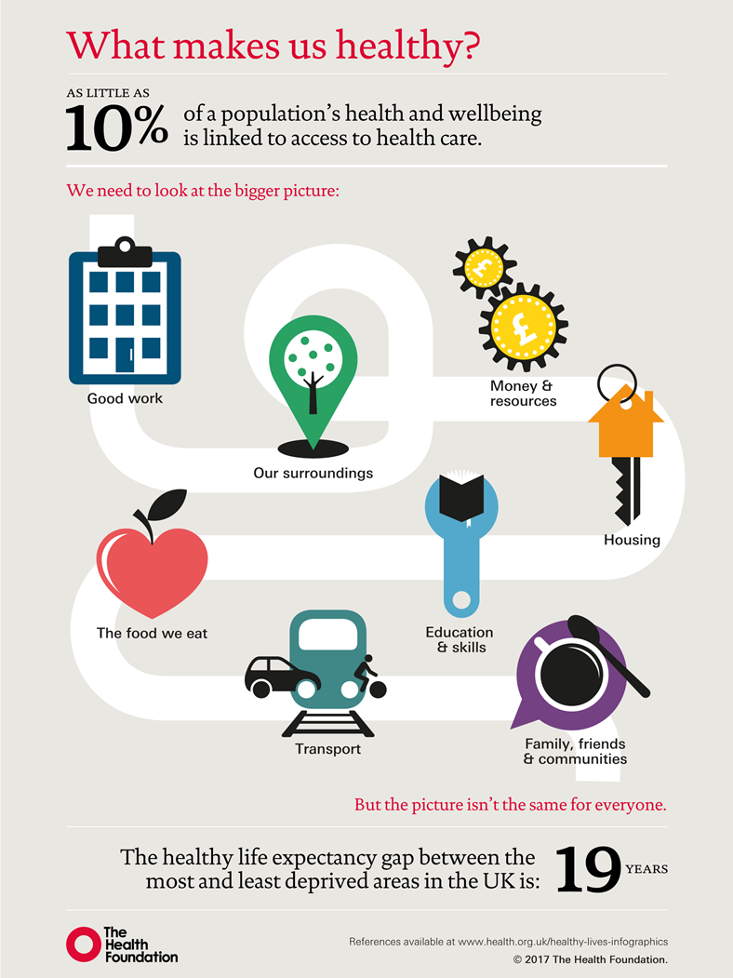
Social Prescribing Link Workers focus on the social determinants of health
As little as 10% of a population’s health and wellbeing is linked to access to health care
Helping people to address the social issues in their lives will help improve their physical and mental health
People experiencing health inequalities are likely to need more help and support and social prescribing is a positive opportunity

Slide 5
What Does Good Social Prescribing Look like for Individuals?
People, their families and carers;
Can easily be referred to social prescribing link workers from the Surgery and a wide range of local agencies or self-refer.
Work with a link worker to coproduce a simple plan or a summary personalised care and support plan
Help to engage with services there to support. May follow-up services on their behalf
May be physically introduced to community groups
Are encouraged to develop their knowledge, skills and confidence by being involved in local community groups and giving their time back to others.
The sense of belonging that comes from being part of a community group and having peer support can reduce loneliness and anxiety.
Being connected to community groups through social prescribing enables people to be more physically active and improves mental health, helping them to stay well for longer and lessen the impact of long-term conditions.

Slide 6

It is a Change of Focus
“What’s the matter with me” to “What matters to me”
Strengths rather than deficit
Builds on existing assets
Connects me to my communities
Offers me a greater choice of opportunity & help that’s non-medical
Meet new people and make new relationships including volunteering
Build my self-responsibility, take control, engaging, empowering
Improve my health and well being
More enjoyable and/or rewarding

Slide 7
What can patients expect from a Social Prescriber?
6 to 12 sessions – can be more or less depending on the person
Conversation based, usually 1hr – 1.5hr
Health coaching approaches
Well being plan – setting goals
Personalised care approach

Slide 8
Who can be referred?
25 – 40% of patients present with social issues
Discrete groups of patients – carers, parents, Long Term Conditions
Can be from any practice staff not just GPs
Over time from any agency – police, social care, housing, DWP, self-refer
Issues – self-esteem, loneliness, financial, employment, volunteering, lifestyle, activity, advocacy, lower level mental health,
Earlier the prevention the better.
Must want to make changes. (Culture and behavior change)

Slide 9
Thank you for your time and attention chloe.baker9@nhs.net
Social Prescriber, Cambridge City PCN

