Slide 1


Well-being & Mental Health
Bottisham Medical Practice
25th May 2021
Dr Tamara Keith

Slide 2
Outline...
Signs of stress & burnout
Signs of depression
Mental health crisis
Support available
Questions

Slide 3




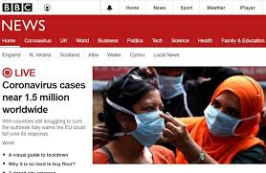



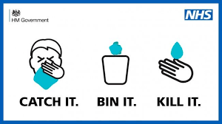

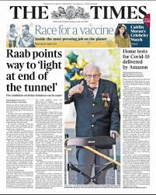



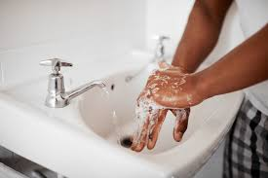

Slide 4

STRESS

Slide 5
Recognising stress
Less energy
Feel emotions more strongly
Hyperactive and anxious
Putting in more effort at work than usual for same productivity

Slide 6

Tips to decrease stress & increase energy
Eat & drink well
Exercise & get outside
Learn something new
Meditation or mindfulness
Engage in something you enjoy
Listen to old music
Make a list of tasks to be completed each week: a sense of purpose & control is stabilising
Breathing techniques
Connect with others
Take time out from social media & news
Do not do everything on this list all at once!
Notes:
1) Meditation -
https://youtu.be/ZToicYcHIOU
https://youtu.be/5syrI8cuyzQ
2) Learn - read a book that's been sitting on your shelf gathering dust. Or download a free trial audible book. Remember to cancel your trial subscription if you can't afford it ☺️
https://www.scribd.com
Eat well
https://www.bbcgoodfood.com/recipes/category/all-healthy
10) Breathe deeply - try this Wim Hoff method.
https://youtu.be/tybOi4hjZFQ
https://youtu.be/Yq5pJ0q3xuc
12) Deal with problems as they arise. A lot of people are in debt right now. There are solutions and organisations that can help. If you are feeling unwell or you are in pain, reach out. You will instantly feel better once you take responsibility and take action. Act now to relieve the burden!
Debt
https://www.stepchange.org/how-we-help.aspx
Mental Health
https://www.mind.org.uk/
https://www.samaritans.org/
Pain
https://www.thebraincharity.org.uk/how-we-can-help/practical-help/information-advice/living-with-a-condition/coping-with-chronic-pain
13) Give yourself a break. Be gentle with yourself. Allow yourself this time. Remember everything passes eventually.
14) Take time out from social media and the news for a while. Nothing will dramatically change in 24 hours.
15) Practice not taking things personally. People have thier own filters and are working through thier own shit right now. Judgement is depleting... understanding and compassion leave an energy surplus.
16) Stretch - Our mind and body are always in conversation. Whether you're 18 or 80, the benefits are huge.
17) Do not do everything on this list and try everything at once. Take your time and work through what resonates with you. ☺️

Slide 7
Recognising burnout describes a severe stress condition that leads to severe physical, mental, and emotional exhaustion.
Early: Exhaustion with increased commitment to goals
Insomnia, trouble concentrating
Reduced commitment to work and others
Emotional reaction: depression, anger, anxiety, irritability
Isolation from others, no time for non work activities
Reduced efficacy: apathy, loss of productivity, reduced motivation
Physical symptoms: palpitations, chest or stomach pains, fainting, dizziness, loss of appetite
Frequent illness
https://www.healthline.com/health/tips-for-identifying-and-preventing-burnout
Notes:
Anyone who’s continually exposed to high levels of stress can experience burnout. Helping professionals, such as first responders, doctors, and nurses are especially vulnerable to this health condition
Warning symptoms in the early phase
Increased commitment to goals
Exhaustion
Reduced commitment
Towards patients and clients
Towards others in general
Towards work
Increased demands
Emotional reactions; blaming
Depression
Aggression
Reduced
Cognitive performance
Motivation
Creativity
Judgment
Flattened
Emotional life
Social life
Intellectual life
Psychosomatic reactions
Despair

Slide 8
Stress unavoidable, but burnout is preventable
Exercise
Exercise: mini workouts and short walks, make a daily habit
Eat
Eat a balanced diet
Sleep
Practice good sleep habits
Caffeine
Avoid caffeine before bedtime
Relax
Establish relaxing bedtime routine (ban smart phones from bedroom!)
Ask
Ask for help: Friends, family, GP

Slide 9
Depression screening questions
In the past month have you:
Felt down or depressed or hopeless?
Been bothered by little interest or pleasure in doing things?

Slide 10
Specific questions for depression
Little interest or pleasure in things
Mood: low, down, depressed, hopeless
Sleep
Energy levels
Appetite
Concentrating
Speaking & moving slowly or more rapidly
Feeling bad about yourself, like you’ve let yourself or family down
Thoughts of self harm or suicide

Slide 11
Don’t be afraid to ask someone if they are feeling low

Slide 12
Don’t be afraid to ask someone if they are so low they would rather not be alive

Slide 13
You could save a life

Slide 14
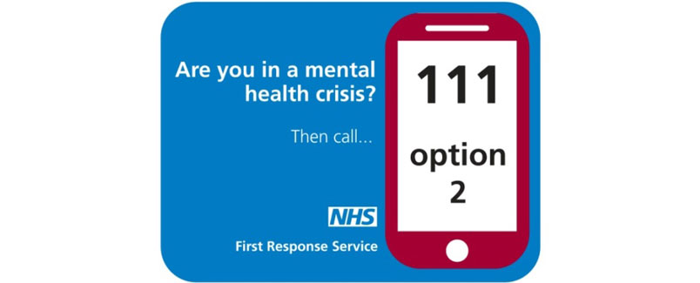

Slide 15
What is a mental health crisis?
You, or someone you know, might be in crisis if:
You are thinking of hurting yourself or suicide seems the only option
Someone you know has made threats to hurt you or someone else
You are experiencing extreme distress that seems overwhelming

Slide 16
Who can help in a mental health crisis?
Call 111 and press option 2 for the First Response Service
24-hour service
Trained mental health staff
Police: if you or someone is in immediate danger or someone is at immediate risk to others, ring 999.

Slide 17
Local Support
& looking after you

Slide 18
www.keep-your-head.com
Keep Your Head brings together reliable information on mental health and wellbeing for children, young people and adults across Cambridgeshire & Peterborough

Slide 19
Adults

Slide 20
www.keep-your-head.com
Depression & anxiety
Mental health crisis
Bereavement
Counselling & CBT
Counselling after a childhood death or miscarriage or stillbirth: SANDS, Petals
Eating disorder help
Carers support
Dementia support

Slide 21

Psychological well-being service
Aged 17 and over
Help those with common mental health problems such as depression and anxiety disorders, post-traumatic stress disorder; health anxiety; panic; phobias and obsessive compulsive disorder
Stress, low confidence, sleep disturbance and self-esteem issues.
https://www.cpft.nhs.uk/psychological-wellbeing-service/
T: 0300 300 0055
E: selfreferiapt@cpft.nhs.uk

Slide 22

Meditation and Mindfulness
www.headspace.com
https://www.calm.com

Slide 23
Children

Slide 24
LIFELINE
FREEPHONE 0808 808 2121
11am – 11pm every day
Free, confidential and anonymous telephone helpline service that is currently available from 11am – 11pm every day.
Support and information to someone experiencing mental distress or if you are supporting someone in distress
It is run by Lifecraft, a user-led organisation for adults in the Cambridgeshire and Peterborough area who have experience of mental health difficulties in their lives
Notes:
is a confidential support and advice service from 9am – midnight every day of the year (Weekends and Bank Holidays included) for:
Children and Young People under the age of 35 who are experiencing thoughts of suicide
Anyone concerned that a young person could be thinking about suicide
FREEPHONE 0808 808 2121
11am – 11pm every day
Lifeline is a free, confidential and anonymous telephone helpline service that is currently available from 11am – 11pm every day. The Line provides listening support and information to someone experiencing mental distress or if you are supporting someone in distress. Callers are supported by trained volunteers under the guidance of the shift supervisor. It is run by Lifecraft, a user-led organisation for adults in the Cambridgeshire and Peterborough area who have experience of mental health difficulties in their lives.
FREEPHONE 0808 808 2121
11am – 11pm every day
Lifeline is a free, confidential and anonymous telephone helpline service that is currently available from 11am – 11pm every day. The Line provides listening support and information to someone experiencing mental distress or if you are supporting someone in distress. Callers are supported by trained volunteers under the guidance of the shift supervisor. It is run by Lifecraft, a user-led organisation for adults in the Cambridgeshire and Peterborough area who have experience of mental health difficulties in their lives.

Slide 25

Phone us on 0333 4141809
Text us on 07514 783745
Email us at help@centre33.org.uk
https://centre33.org.uk/
Supporting young people up to
the age of 25 with mental health,
caring responsibilities, housing,
sexual health and more.
If you need someone to talk to, our phone, text and WhatsApp lines are open between 12-5pm Monday
to Friday and 10am-1pm on Saturdays. Outside of our opening hours please leave a voicemail or email.
We aim to get back to you within 24 hours*.

Slide 26
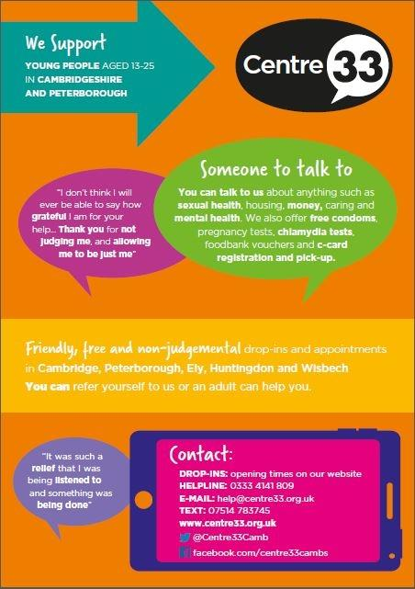

Slide 27

Offers support to children and young people with mild to moderate mental health difficulties, such as anxiety and low mood, as well as those with significant emotional wellbeing difficulties arising from life events such as bereavement and bullying.
Peterborough Up to 18 years
Cambridgeshire – Up to 25 years old
You can make a referral via the website http://chums.uk.com/cambs-referral-forms and one of their triage team will contact you to discuss in more detail.
Peterborough 0330 0581 657
Cambridgeshire 0330 0581 659

Slide 28

A secure and confidential text messaging service for young people aged 11-19 across Cambridgeshire and Peterborough who are struggling to cope with issues such as bullying, emotional health, relationship problems, alcohol and drugs.
Notes:
ChatHealth opens a new line of communication for young people across Cambridgeshire and Peterborough
The Cambridgeshire and Peterborough Healthy Child Programme has successfully implemented ChatHealth – a secure and confidential text messaging service for young people aged 11-19 across Cambridgeshire and Peterborough who are struggling to cope with issues such as bullying, emotional health, relationship problems, alcohol and drugs.
The confidential text messaging service opens a new line of communication to young people and gives them an excellent opportunity to anonymously get in touch with a healthcare professional for that much-needed support with a simple touch of a button.

Slide 29

FREE Silent Meditation links
https://youtu.be/ZToicYcHIOU
https://youtu.be/5syrI8cuyzQ

Slide 30
Breath deeply
Wim Hoff method
https://youtu.be/tybOi4hjZFQ

Slide 31
Websites for childhood mental health support
1. Royal College Of Psychiatrists : www.rcpsych.ac.uk/mental-health/parents-and-young-people/young-people/worries-and-anxieties
This has a useful Q and A section for children and includes case studies.
2. Moodgym.com.au :Online interactive self-help programme for 16+ year olds who suffer with anxiety or depression. Based on cognitive-behavioural methods. There is an annual cost (approx. £28).
3. Youngminds.org.uk: Information and resources for children,Helpline. Signposting for support. Educational materials.
4. Stem4.org.uk : A charity that promotes positive mental health in teenagers and those who support them through education, resilience strategies and early intervention. Provided digitally through education programmes, apps, website and mental health conferences.
5. Kooth.com counselling and support for children and young people.
6. Getconnected.org.uk : Volunteers available 24/7 to offer support on a range of issues eg self-harm, bullying, drugs etc.
7. Moodcafe.co.uk/for-children-and-young-people/relaxation-for-children.aspx : helpful relaxation exercises for children with anxiety.
8. www.cool2talk.org : A safe space for children aged 12+ years to have their questions answered accurately, and can access online counselling.

Slide 32
Audible stories:
Give yourself 5 mins peace!
https://stories.audible.com/start-listen
https://bit.ly/AudioElevenses

Slide 33
Tumble tots!
https://m.youtube.com/playlist?list=PLPy56tmTI89AlYwablw5FPhkJKJNvpjPQ
Toddler and preschool age ideas
https://preschoolinspirations.com/

Slide 34
NHS Apps Library www.nhs.uk/apps-library/

Slide 35

Space to talk
Questions
Notes:
TK&FL

